Slide 1


AI-Powered Smart Energy Consumption Predictor
A Project Report for Inhouse Training
Submitted by: Team Volt Squad
Ayushi Rani • Somya Ranjan • Aranya Roy
Mentor: Debasish Sahoo Sir | Institution: Haldia Institute of Technology

Slide 2

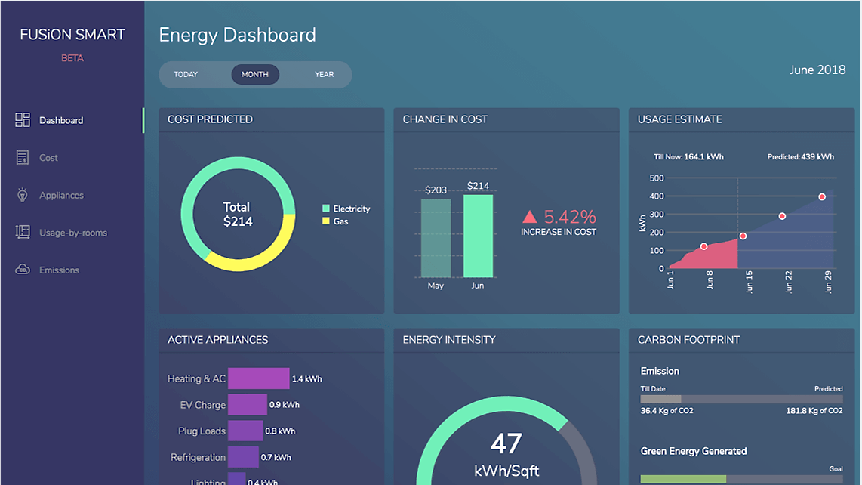

Executive Summary
Energy consumption forecasting is vital for modern Smart Cities and sustainable development. This project focuses on predicting household energy usage using advanced Machine Learning techniques.
Integrated Flask-powered backend.
Interactive web-based frontend.
Real-world factor analysis (Temp, AC, Size).

Slide 3





Project Context & Objectives
Motivation
Core Goal
Technical Scope
Global energy demand is rising. Efficient utilization is critical for climate goals and personal budget management.
To design an AI model that assists households in making informed decisions about electricity consumption.
ML Model design, Frontend UI build, Flask API deployment, and Performance evaluation.

Slide 4

Dataset Description
The dataset consists of household-level records with critical features affecting power usage:
Feature | Description
Household Size | Number of residents in the house.
Avg. Temp (°C) | Environmental temperature impacts.
Has AC | Binary feature (1: Yes, 0: No).
Peak Usage | kWh consumed during peak hours.
Preprocessing Steps
Missing value handling
Train-Test Split (80/20)
Feature scaling/encoding

Slide 5

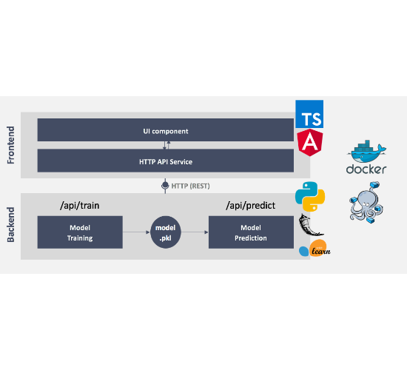
System Architecture
Client-Server Workflow
Frontend: Captures user inputs via interactive Glassmorphism UI.
API: Data is sent to the Flask backend via POST requests.
Processing: Backend loads the Joblib-trained ML model for inference.
Output: Predictions are returned in JSON and displayed to the user.

Slide 6








Technological Stack
Frontend
Backend
Machine Learning
Deployment
HTML5, CSS3 (Glassmorphism), JavaScript (Fetch API)
Python, Flask Framework, Flask-CORS
GitHub (Source Control), Render (Cloud Hosting), Gunicorn (Server)
Scikit-learn, NumPy, Pandas, Joblib Serialization

Slide 7

Machine Learning Approach
Random Forest Regressor
We selected Random Forest Regression over standard Linear Regression for its superior handling of complex, non-linear relationships between variables.
Model Type
Regression
Ensemble technique using 100 decision trees.
Suitable for continuous numerical value prediction (kWh).
Reduces overfitting through averaging.
Captures intricate feature interactions.

Slide 8

Mathematical Evaluation
The model performance is evaluated using Mean Squared Error (MSE) and R² Score metrics:
Mean Squared Error (MSE)
Coefficient of Determination (R²)

Slide 9
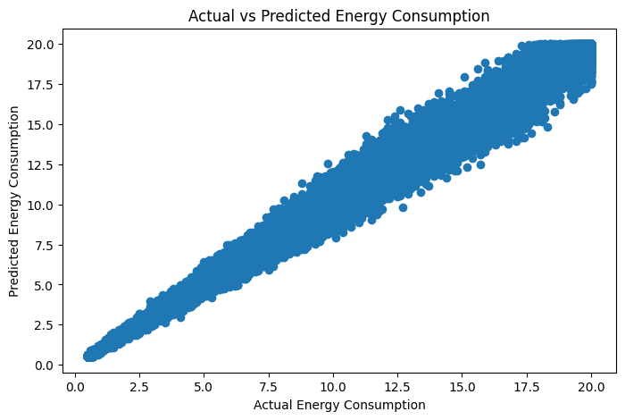

Results & Analysis
Evaluation Metrics
MAE: ~8.52
RMSE: ~0.72
R² Score: 0.9829 (Excellent)
The high R² score indicates the model explains 98.3% of the variance in electricity consumption, demonstrating exceptional predictive accuracy.

Slide 10
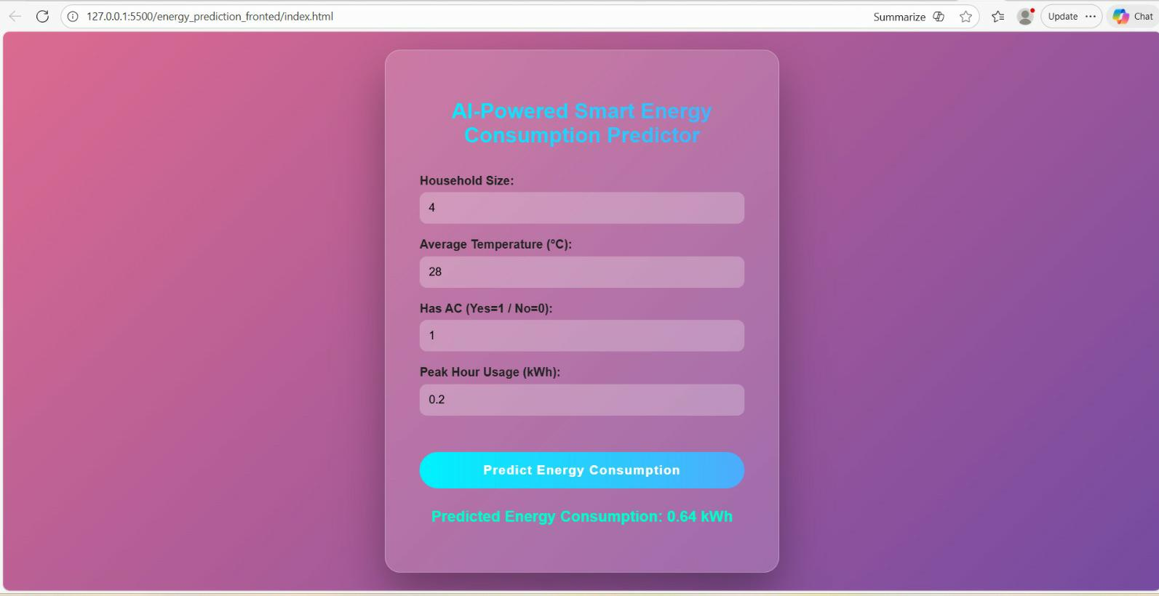
Project Frontend

Slide 11




Deployment Strategy
GitHub
Render
Version control with modular directories for Frontend and Backend.
Cloud hosting for Flask backend using production-ready WSGI (Gunicorn).

Slide 12


System Evaluation
Advantages
Limitations
Real-time, scalable predictions.
Dependency on data quality/size.
Intuitive glassmorphism interface.
Lacks appliance-level granularity.
Low computational overhead for inference.
Assumes static household dynamics.

Slide 13

Conclusion & Future Work
The AI-Powered Smart Energy Consumption Predictor successfully illustrates the power of ML in energy management. The end-to-end integration provides a viable tool for household energy planning.
Q & A
Next Steps:
Thank you for your attention!
Integration with IoT Smart Meters.
Team Volt Squad
Real-time Weather API integration.
Ayushi | Somya | Aranya
Advanced Deep Learning (LSTM) models.
Mobile App development.

